Slide 1
WAITLIST ANALYTICS DASHBOARD OVERVIEW.
Insights into patient wait times and trends (Jan 2018 - Mar 2021)
By Knight Bwari Zablon.
Power BI Project
Power BI Link
healthCare project.pbix

Slide 2
Introduction
Objective: The purpose of the analysis and dashboard—monitoring patient wait times across different specialties and case types (Outpatient, Inpatient, Day Case) using Power BI
Process:
Data collection from healthcare records (2018-2021 NHS).
Transformation and modelling
Data visualization blueprint.
Dashboard layout and design.
Interactivity and design
Testing
Maintenance and refresh.
Key Insight: A data-driven approach to managing waitlists can directly impact service delivery and patient outcomes.

Slide 3
Overall objectives
Track current status of patient waiting list
Analyze historical monthly trends of waiting list in inpatient and outpatient categories
Detailed specialty level and age profile analysis.
Metrics used
Average and Median waiting list
Current total wait list
Views required
Summary page
Detailed page of granular analysis

Slide 4
Key Metrics and Definitions
Case Type refers to Outpatient, Day Case, Inpatient.
Time Bands is the duration in which data was recorded eg 0-3 months, 3-6 months, etc.
Age Profiles refers to the age of the people whose data was collected and Specialties the different types of health issues they had.
Users can filter to drill into specific trends or insights (e.g. Archive Date, Case Type, Specialty Name, Age Profile).
Process:
Data categorization by these metrics allows for a deeper, segmented understanding of wait times.
Key Insight: Defining metrics clearly enables stakeholders to interpret the data accurately, leading to actionable decisions.

Slide 5
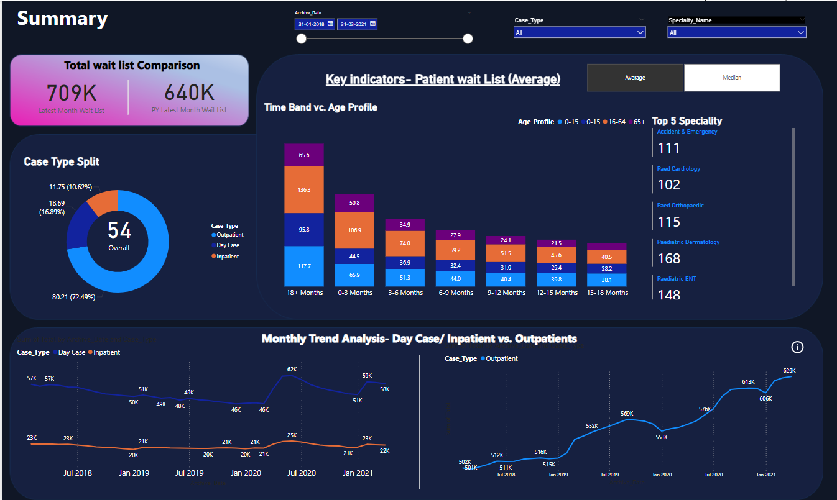

Slide 6
Deep Dive into the Dashboards
Dashboard Overview
Purpose of the Dashboards:
The dashboards were designed to visualize and analyze the patient waiting lists over the period from January 2018 to March 2021, helping healthcare providers understand wait times, case types, specialties, and patient profiles.
Data Sources:
Archive of healthcare records from a central database, segmented by age groups, case types (Outpatient, Inpatient, and Day Case), and specialties (e.g., Dermatology, Orthopaedics).
Time Period:
Time range: January 2018 – March 2021
2. Visual Insights by Dashboard Section
Summary Dashboard:
Total Waitlist Comparison:
In the last month, the total waitlist hit 709K, compared to the previous year’s 640K, highlighting a 10% increase.
Key Indicator: Patient Waitlist by Time Band vs Age Profile:
Age group 0-15 years has the highest percentage of patients waiting more than 18 months.
65+ age group shows significant wait times within 0-3 months, suggesting priority treatments for the elderly.
Case Type Split:
Outpatient cases dominate with over 72% of the overall load, followed by Inpatient (16.69%) and Day Case (10.62%).
Monthly Trend Analysis:
A clear trend emerges of increasing outpatient cases, peaking at 62K by January 2021, whereas inpatient cases remain relatively stable over time.

Slide 7
Waitlist Comparison
A comparative view of the total waitlist, showing the difference between the current month
(709K patients) and the same month in the previous year (640K patients).
Process:
Data is collected monthly and compared year-over-year.
Analyzed why there was an increase in patient numbers (possible pandemic influence,
elective surgery delays, etc.).
Insight: The growth in patient numbers indicates increasing strain on healthcare resources,
signaling the need for improved scheduling and capacity planning.

Slide 8
Case Type Breakdown
A breakdown of patient cases shows that Outpatients dominate (72.49%), followed
by Day Case (16.89%) and Inpatient (10.62%).
The donuy chart visualizes the case split across the three types.
Process:
Outpatient services are more common due to the nature of certain specialties and healthcare
policies (e.g., increased focus on outpatient treatments to reduce hospital stays).
Insight: This breakdown is critical for allocating resources where they are most needed, particularly for
outpatient services that dominate patient traffic.

Slide 9
Wait Times by Age Profile and Time Band
Content:
The bar chart shows patient wait times across various age groups (0-15, 16-64, 65+) and how
long patients have waited (0-3 months, 3-6 months, etc.).
Process:
Data was segmented into age groups and mapped against waiting times for better understanding of
waitlist burden.
Identify trends like children (0-15) having longer wait times in some bands, possibly due to specialization
demand in pediatric care.
Insight: Age-based trends in wait times highlight the need for focused improvements in specific services for
vulnerable groups, such as children and the elderly.

Slide 10
Top Specialties by Patient Load
Top five specialties with the highest patient load: Accident & Emergency (111 patients), Paediatric
Cardiology (102 patients), Paediatric Orthopaedic (115 patients), etc.
Process:
Specialties with long waitlists were prioritized for analysis to target areas that require immediate
attention.
Insight: Specialties like emergency services and pediatric care are under the most pressure,
suggesting where resources should be focused.

Slide 11
Monthly Trends Analysis
Line charts display the monthly trends of Day Case, Inpatient, and Outpatient numbers from July 2018 to January 2021.
Process:
Tracked patient numbers across these periods to observe how cases have fluctuated, with a spike in outpatient cases.
Events like the COVID-19 pandemic affected these trends, leading to a backlog in non-emergency services.
Insight: The increasing outpatient trend shows that more resources need to be allocated to outpatient services as this category is consistently growing.

Slide 12
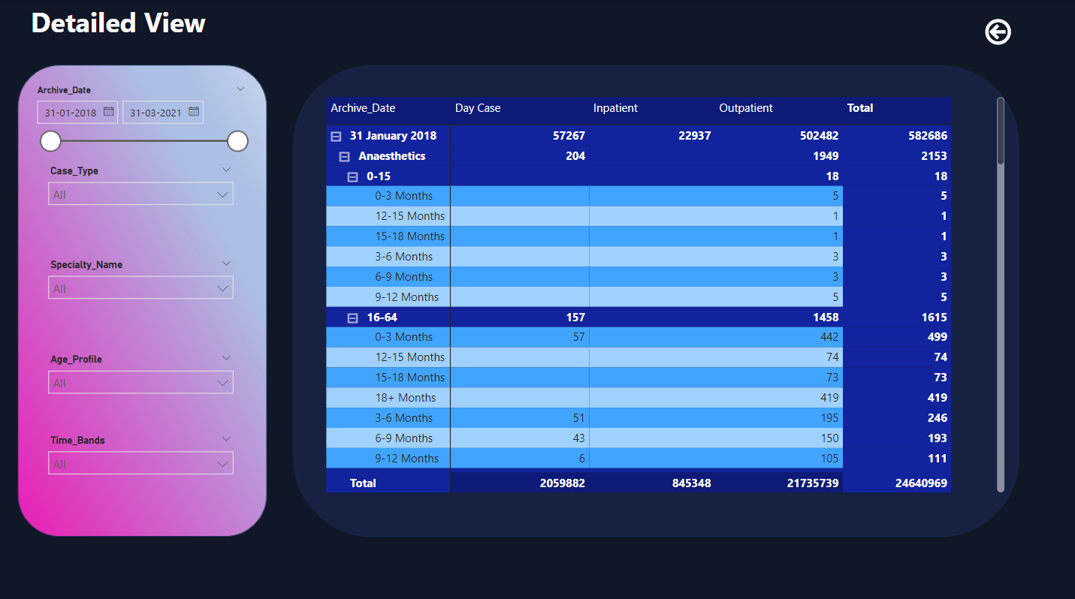
Detailed View Dashboard:

Slide 13
Granular Breakdown
This dashboard allows for further slicing of the data based on age group, specialty, and time band.
Specialty-wise, Paediatric Dermatology and Paediatric ENT show the highest waitlist volumes, emphasizing where bottlenecks are forming.
For example, in the specialty of Anaesthetics, there were 204-day cases as of 31st January 2018, of which 157 were in the 16-64 age group.
Customization:
Users can filter by case type, specialty, or specific age profiles to get tailored insights.

Slide 14
Analytical Observations
Long Wait Times: The majority of the patients have been waiting for over 6 months, highlighting areas where capacity needs to be expanded.
Case Type Insights:
Outpatient cases are increasing steadily, potentially due to non-critical treatments being delayed during this time period.
Specialties like Accident & Emergency, Paediatric Orthopaedics, and Paediatric Dermatology require more resource allocation to manage demand.

Slide 15
Strategic Actions:
Resource Reallocation: Based on waitlist trends, staffing and resource investments should be targeted towards high-volume specialties like Accident & Emergency and Paediatrics.
Capacity Planning: Expansion of outpatient services should be prioritized to accommodate the increasing case volume.

